Slide 1
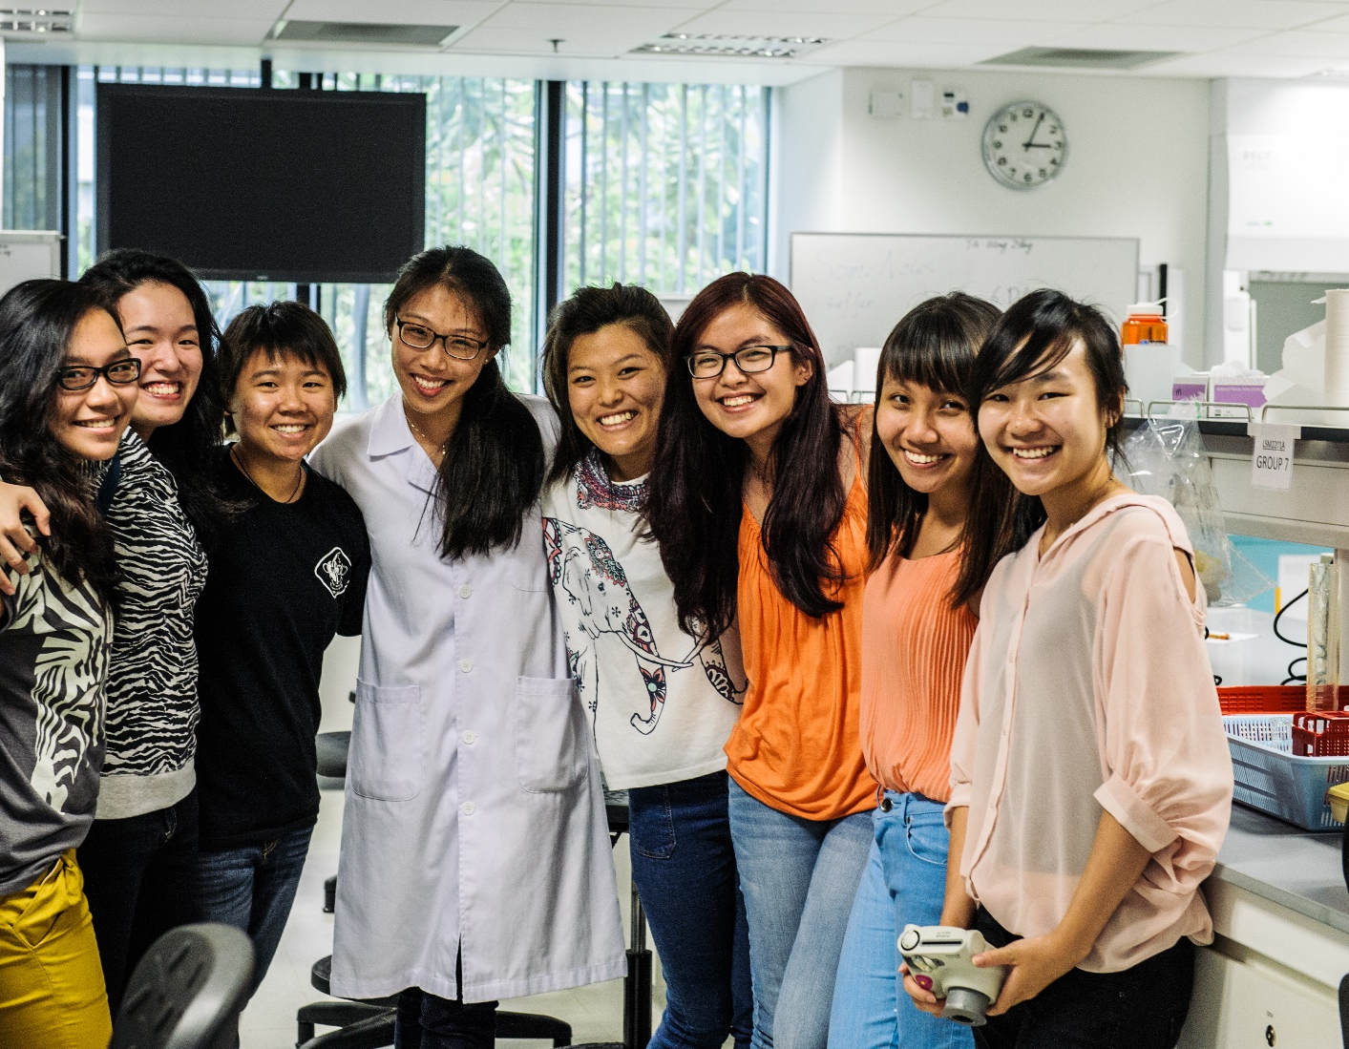
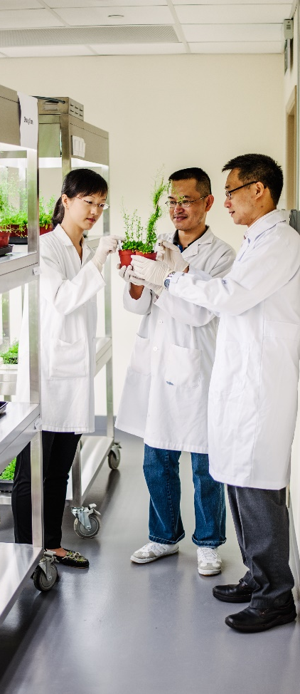
Graduate Studies in Life Sciences
National University of Singapore
新加坡国立大学生命科学奖学金
The Department of Biological Sciences (DBS), National University of Singapore (NUS), The Mechanobiology Institute (MBI) and Cancer Science Institute Singapore (CSI), offer many generous 4-year bond-free scholarships. We seek outstanding students in Biology, Mathematics, Chemistry, Physics, Computational Science and Engineering to join our graduate programs in year 2016. If interested, please provide your dossier, which should include your academic transcript, research interests and achievements. The department will conduct either on-site (time permitting) or phone interviews at a later date.
Free Admission
Venue: Southeast University
 | Program
 | Friday, 22 May 2015 | Venue
10.00am – 10.30 am | Scientific Talk: Molecular insights into non-coding RNA and CRISPR RNA processing Adam Yuan, Assoc Professor, Department of Biological Sciences, NUS | 东南大学四牌楼校区李文正楼南楼213
11.00am – 12.00pm | Graduate programs in DBS, MBI and CSI Hew Choy Leong, Emeritus Professor, Department of Biological Sciences, NUS | 东南大学丁家桥校区综合楼106
Contact information
Professor Hew Choy Leong Mobile (China) : 134 590 33580 | Email: dbshewcl@nus.edu.sg
For more information, please visit the websites of
DBS (www.dbs.nus.edu.sg) | MBI (mbi.nus.edu.sg) | CSI (www.csi.nus.edu.sg)

